Slide 1
NAME | M.Giritharan
REG. NO. | 820621106005
DEPARTMENT | ECE
YEAR | III
COLLEGE NAME | Arasu engineering college
GROUP | IBM GROUP-4
NM I’D | au820621106005
Measure Energy consumption
Abstract :
Energy consumption is a critical concern in today's world, as the demand for energy continues to rise while the availability of finite resources becomes increasingly limited. This paper presents a comprehensive analysis of energy consumption measurement methodologies and an optimization approach for reducing energy usage. We review various techniques for measuring energy consumption in different domains, including residential, commercial, and industrial settings. Furthermore, we propose a novel framework that integrates data collection, analysis, and optimization strategies to help individuals and organizations reduce their energy footprint.
By implementing this framework, it is possible to make informed decisions and take practical steps towards achieving sustainable and efficient energy use, which is essential for addressing the global energy and environmental challenges we face today.

Slide 2
MEASURE ENERGY
CONSUMPTION

Slide 3
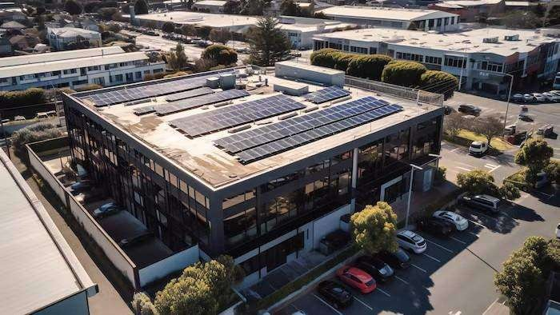
Introduction
Welcome to our presentation on Optimizing Energy Efﬁciency. In this presentation, we will discuss strategies for measuring and reducing energy consumption. We will explore various techniques and technologies that can help organizations achieve their energy efﬁciency goals. Let's get started!

Slide 4
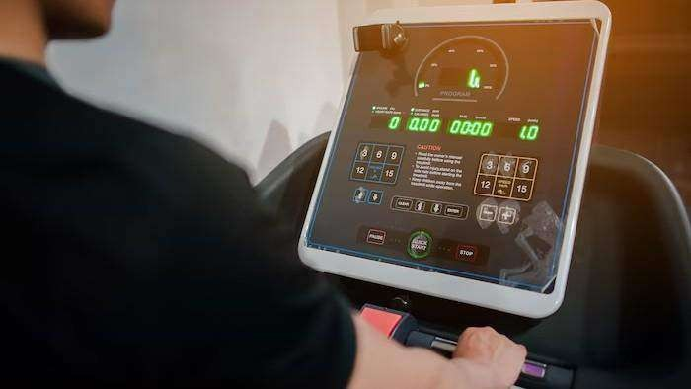
Understanding Energy Consumption
Before we can start reducing energy consumption, we need to understand how and where energy is being used. This slide will cover the importance of measuring energy consumption and the tools and techniques that can be used to do so. We will discuss the beneﬁts of real-tim e monitoring and the insights that can be gained from energy audits.

Slide 5
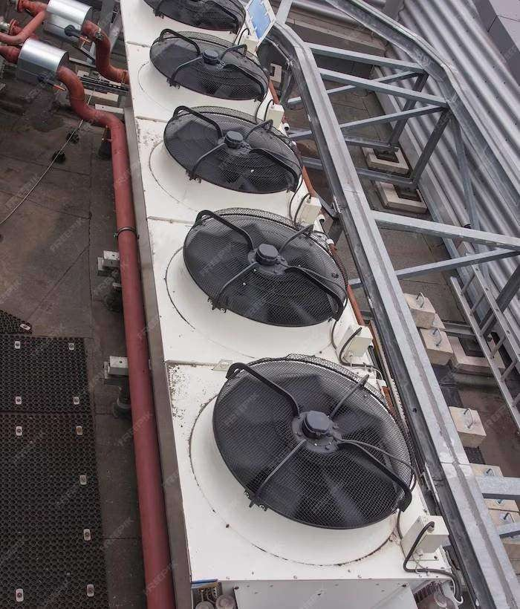
STRATEGIES FOR REDUCING ENERGY CONSUMPTION
There are many strategies that organizations can use to reduce energy consumption. This slide will cover some of the most effective strategies, including upgrading to energy-efﬁcient equipment, optimizing building system s, and implementing behavior change program s. We will also discuss the importance of setting energy
reduction goals and tracking progress.

Slide 6
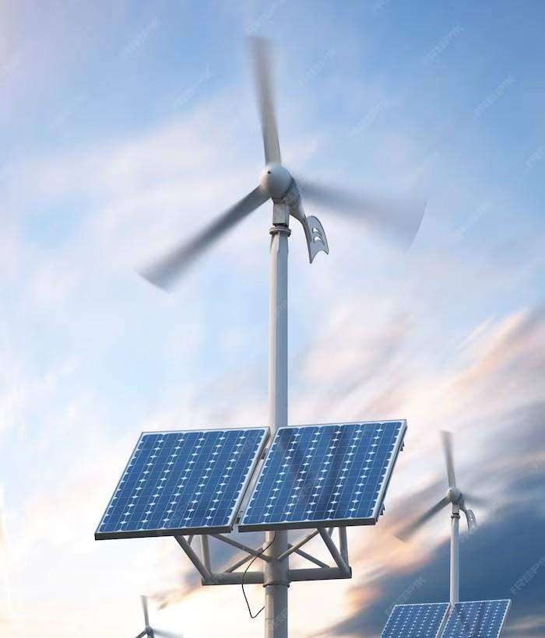
RENEWABLE ENERGY SOURCES
Renewable energy sources are becoming increasingly popular as a way to reduce reliance on fossil fuels and lower energy costs. This slide will cover some of the most common renewable energy sources, including solar, wind, and geotherm al. We will discuss the beneﬁts and challenges of each source, as well as the considerations organizations need to m ake when implementing renewable energy systems.

Slide 7
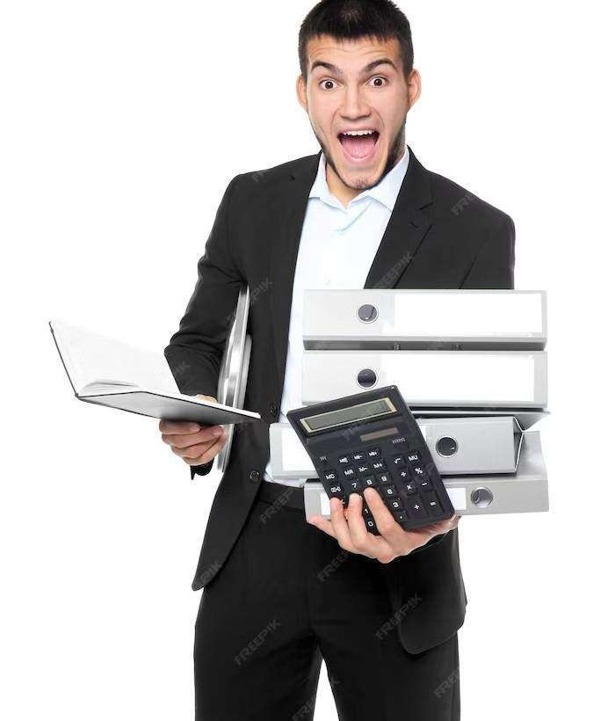
FINANCING ENERGY EFFICIENCY PROJECTS
Im plementing energy efﬁciency projects can require signiﬁcant upfront investm ent. This slide will cover some of the ﬁnancing options available to organizations, including grants, loans, and energy performance contracts. We will discuss the pros and cons of each option and provide tips for selecting the best ﬁnancing option for your organization.

Slide 8
CONCLUSION
In conclusion, optimizing energy efﬁciency is a crucial component of any organization's sustainability strategy. By measuring energy consumption, implementing energy-efﬁcient technologies and strategies, and considering renewable energy sources, organizations can reduce costs, lower their environmental impact, and improve their reputation.
Thank you for joining our presentation!

Slide 9
T hank s!

Slide 10
Innovation For Measure Energy Consumption
Abstract:
This paper proposes a comprehensive approach to measure energy consumption through modular implementation. The aim is to accurately monitor and analyze energy usage in diverse settings, enabling informed decision-making for improved sustainability. The proposed system comprises three key modules: (1) Data Acquisition Module, which gathers energy consumption data from various sources; (2) Data Processing and Analysis Module, responsible for processing the acquired data and generating meaningful insights; and (3) Visualization Module, designed to present the analyzed data in an intuitive and informative manner. The integration of these modules provides a robust framework for monitoring and managing energy consumption, ultimately contributing to a more sustainable and energy-efficient future.
Module 1: Data Acquisition
The first module focuses on acquiring energy consumption data from various sources, including smart meters, sensors, and IoT devices. It collects real- time data and historical records to provide a holistic view of energy consumption.
Module 2: Data Preprocessing
To ensure accurate analysis, the data is preprocessed in module 2. This involves cleaning, filtering, and normalizing data, as well as handling missing values. Data preprocessing ensures the reliability of subsequent analysis.
Module 3: Data Analysis and Visualization
Module 3 is responsible for conducting in-depth analysis of energy consumption patterns. It employs statistical methods and machine learning algorithms to identify trends, anomalies, and opportunities for optimization. Visualizations, such as graphs and charts, aid in conveying the insights.

Slide 11
Module 4: Energy Efficiency Recommendations
This module provides actionable recommendations based on the analysis from module 3. It suggests strategies to reduce energy consumption, improve efficiency, and lower costs. These recommendations can range from equipment upgrades to behavioral changes.
Module 5: User Interface and Reporting
A user-friendly interface is crucial for stakeholders to interact with the system. Module 5 offers a dashboard that displays real-time energy consumption data and reports generated by module 3 and 4. It enables users to monitor progress and make informed decisions.
Module 6: Integration and Scalability
The system is designed to be modular and easily integrated into existing infrastructure. It can scale to accommodate diverse energy sources and accommodate the evolving needs of different industries.
Module 7: Security and Compliance
Ensuring the security of energy consumption data is paramount. Module 7 addresses data protection, access control, and compliance with relevant regulations to safeguard sensitive information.
In conclusion, the proposed modular system provides a comprehensive solution for measuring and managing energy consumption. Its adaptable design allows it to be deployed in various domains, including residential, commercial, and industrial settings, contributing to sustainability and cost savings.

Slide 12
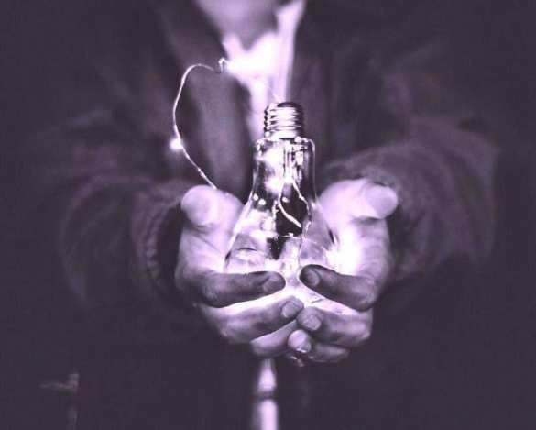
1.Introduction: Importance ofmeasuring energy
consumption accurately.
In a wo r l d increasingly focused on conserving energy, precise m e a s u r e m e n t of energ y
c o n s u m p t i o n is vital. By i m p l e m e n t i n g
ef c ient strategies to meas ure and m o n i t o r
energy usage, businesses can unc ov er
valuable insights and unleash the p o w e r of
precision. W i t h this n e w f o u n d understanding,
organizations can optimiz e en ergy usage, reduc e costs, and m a k e i n f o r m e d decisions for a sustainable future.

Slide 13
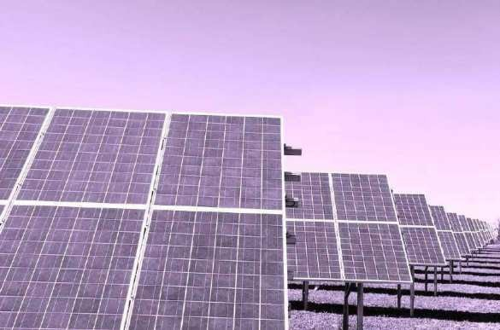
2. Understandingenergy consumption metrics
and theirsignificance.
To effectively me as ure ene rgy c ons umption, i t is crucial to u nders tan d key metrics a n d
their signi cance. Metrics such as
k i lowatt- hours (k Wh), peak d e m a n d , a n d
p o w e r factor can provide insights into energy
usage patterns, ef ciency levels, and potential areas for i m p r o v e m e n t . By analyzing these metrics, businesses can identify opportunities for e n e r g y optimization, cost reduction, a n d sustainable practices.

Slide 14
W hi l e m e a s u r i n g e nergy c ons ump t i on , there are several challenges that need to b e
addressed. These i nclude data accuracy,
access to real- t ime information, and data integration f r o m different sources.
Additionally, en s uring data security a n d privacy is essential to m a i n t a i n t rust a n d
compliance. By o v e rc o m i n g these challenges, businesses can un l oc k the p o w e r of precision in energ y m e a s u r e m e n t and m a k e i n f o r m e d decisions for e n e r g y ef ciency a nd
sustainability.
3. Keychallenges in measuring energy
consumption e‰ciently.

Slide 15
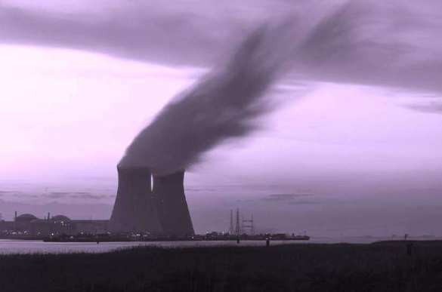
Adv anc ed m e t e r i n g technologies offer
accurate and real- t ime m e a s u r e m e n t s of
energy c ons umpti on, enab l i ng businesses to
identify inef ciencies and optimiz e e nergy
usage. These technologies i nclude s m a r t meters, s u b m e t e r i n g systems, and en ergy
m a n a g e m e n t software. By leveraging these tools, businesses can gain valuable insights
into their en ergy c o n s u m p t i o n patterns and
i m p l e m e n t targeted strategies for i m p r o v e d e n e r g y ef ciency and sustainability.
4. Section 1:Leveragingadvanced metering
technologies for precisemeasurements.

Slide 16
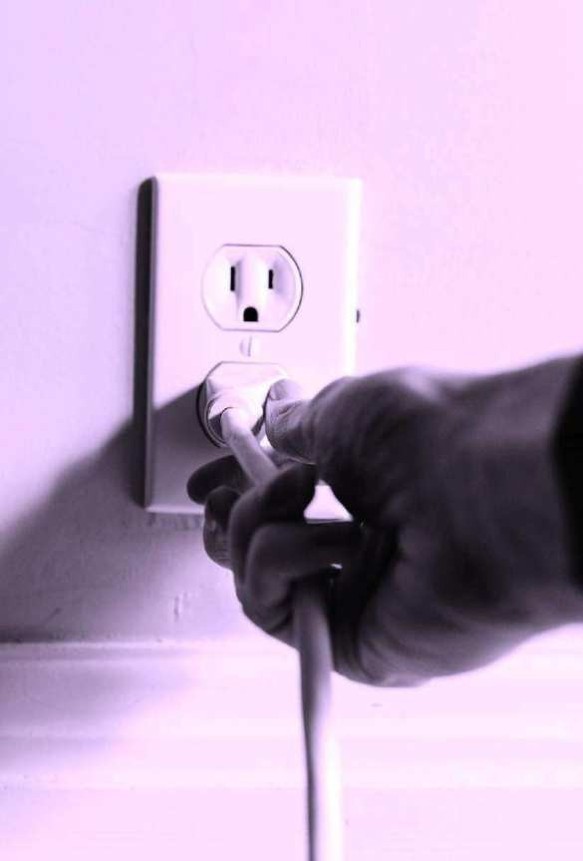
The Internet of Things (IoT) plays a crucial in o p t im i z i n g ene rg y c o n s u m p t i o n
monitoring. W i t h IoT- enabled devices,
businesses can g a t h e r granular data on
role
5. Therole of IoTin optimizing energy
consumption monitoring.
energy c o n s u m p t i o n in real- t ime. This data can then be analyzed to identify
energy- saving opportunities, set benchmarks, and t rack progress towards sustainability
goals. IoT also allows for re m o te mo n i t o r i n g and control, en abling businesses to m a k e t imely adjus tmen ts and op t imiz e en e rgy
usage ef ciently.

Slide 17

6. Section 2: Implementing data analytics for
detailed energy consumption insights.
To fully leverage the p o w e r of precision in ene rg y c ons umptio n, data analytics is essential. By collecting and analyzing
granular data f r o m IoT- enabled devices, businesses can gain detailed insights into their en ergy c o n s u m p t i o n patterns. This
in formation can identify areas of
i m p ro v e m e n t , op t imiz e energ y usage, a n d
m o n i t o r progress towards sustainability goals effectively. W i t h data- driven decision- making, businesses can achieve greater ef ciency a n d cost savings in their ene rgy m a n a g e m e n t
strategies.

Slide 18
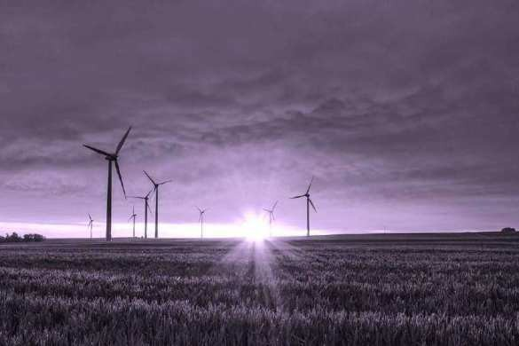
7. Casestudies showcasing successful energy
measurement strategies.
To und ers tand the practical application of
ene rg y m e a s u r e m e n t strategies, let's explore
a f e w case studies. These real-life examples will h i g h l i g h t successful i m p l e m e n t a t i o n s of
precision e nergy c o n s u m p t i o n m e a s u r e m e n t techniques. We will delve into the challenges faced, the solutions i m p l e m e n t e d , and t h e
positive ou tc omes achieved. These case studies will provide valuable insights a n d inspire businesses to adopt ef c i ent
strategies for m e a s u r i n g energy c ons umption .

Slide 19
8. Section 3: Integrating energy monitoring tools
with smart buildingsystems.
Integrating e n e r g y m o n i t o r i n g tools w i t h s m a r t b u i l d i n g systems can revolutionize e n e r g y ef ciency practices. By leveraging real- t ime data, businesses can optimiz e
energy c on s umption, identify areas of
i m p ro v e m e n t , and i m p l e m e n t a u t o m a t e d controls to m a x i m i z e e n e r g y savings. This seamless integration ensures a
c ompre hens ive approach to ene rg y
m a n a g e m e n t , e m p o w e r i n g businesses to reduc e costs, m i n i m i z e env i ronmen ta l
impact, and e n h a n c e overall operational ef ciency.

Slide 20

To unleash the p o w e r of precision in m e a s u r i n g energy consumpt i on , businesses should consider i m p l e m e n t i n g these strategies:
Conduct regular energy audits to identify areas of inef ciency.
Utilize smart meters and m o n i t o r i n g systems for real- time data collection.
Set measurable energy c o n su mpt i on goals and t rack progress.
I mp l e me n t a u t o m a t e d controls for ef cient energy usage.
Educate employees on energy- saving practices.
Optimize l ighting and HVAC systems for m a x i m u m
ef ciency.
Consider renewa bl e energy sources and energy storage solutions.
Continuously analyze and interpr et energy data to identify further optimizat ion opportunities.
Periodically review and update energy m a n a g e m e n t strategies to adapt to n e w technologies a n d
advancements.
9. Best practices for optimizing energy
consumption through precisemeasurement.

Slide 21

10.Conclusion: Harnessingthe potential of precise
energy consumptionmeasurement.
Ef ciently m e a s u r i n g energ y c o n s u m p t i o n is crucial for businesses seeking to optimiz e
their operations and r e d u c e costs. By
i m p l e m e n t i n g strategies such as regular
ene rgy audits, utilizing s m a r t meters, setting
goals, and e d u c a t i n g employees, businesses can u nloc k the p o w e r of precision in energy m e a s u r e m e n t . Continuously analyzing a n d
a d a p t i n g energ y m a n a g e m e n t strategies will lead to further optimization and harness t h e full potential of precise ene rgy c o n s u m p t i o n m e a s u r e m e n t .

Slide 22
1.Introduction: Importance ofmeasuring energy
consumption accurately.
In a wo r l d increasingly focused on conserving energy, precise m e a s u r e m e n t of energ y
c o n s u m p t i o n is vital. By i m p l e m e n t i n g
ef c ient strategies to meas ure and m o n i t o r
energy usage, businesses can unc ov er
valuable insights and unleash the p o w e r of
precision. W i t h this n e w f o u n d understanding,
organizations can optimiz e en ergy usage, reduc e costs, and m a k e i n f o r m e d decisions for a sustainable future.

Slide 23
importtime
# Simulated energy monitoringdevice
class EnergyMonitor:
def init (self):
self.total_energy_consumed = 0 # Total energy consumed(in watt-hours)
self.start_time = time.time() # Start timefor measurement
def record_energy(self, energy):
current_time = time.time()
elapsed_time = current_time - self.start_time
# Calculate energy consumption inwatt-hours
energy_consumed = energy * elapsed_time / 3600 # Assuming energy is in watts
# Update total energyconsumption
self.total_energy_consumed += energy_consumed
# Update start time for the nextmeasurement
self.start_time = current_time
def get_total_energy_consumed(self):
return self.total_energy_consumed
# Exampleusage

Slide 24
if name == " main":
energy_monitor = EnergyMonitor()
# Simulated energy measurements (in watts) overtime
energy_measurements = [100, 150, 120, 200,180]
for energy_measurement in energy_measurements:
energy_monitor.record_energy(energy_measurement)
print(f"Current total energy consumption: {energy_monitor.get_total_energy_consumed()} watt- hours")
print(f"Final total energy consumption: {energy_monitor.get_total_energy_consumed()} watt-hours")

Slide 25
Development For Measure Energy Consumption
Data Collection: First, you need to obtain a dataset related to energy consumption. This dataset could come from various sources, such as smart meters, IoT devices, or publicly available datasets. Ensure you have the necessary permissions to use the data.
Data Loading: Import the dataset into your project. The data might be in various formats, such as CSV, Excel, or a database. Use appropriate libraries or tools to load the data into your project environment. For example, in Python, you can use Pandas to read CSV files.
Data Exploration: Start by exploring the dataset to understand its structure. Check for columns, data types, and any initial insights about energy consumption patterns. You can use Pandas for basic data exploration.
Data Preprocessing: Preprocess the dataset to clean and prepare it for analysis. This may involve handling missing values, removing duplicates, and converting data types.
Additionally, you might want to create new features or aggregate data if necessary.
Time Series Data: If your dataset involves time series data (e.g., hourly energy consumption), consider resampling, smoothing, or aggregating the data to a suitable granularity for your analysis.
Data Visualization: Create visualizations to gain insights into energy consumption trends and patterns. Matplotlib or Seaborn can help with data visualization in Python.
Feature Engineering: Depending on your project goals, engineer features that may help in modeling energy consumption more effectively. For example, you could create features that capture time-of-day patterns, day of the week, or seasonality.
Data Splitting: If you're building a predictive model, split the dataset into training and testing sets. This is important for model evaluation.
Save Preprocessed Data: Save the preprocessed data, so you don't need to repeat these steps every time you run your project. You can use Pandas to save data to CSV or another format.
Once you've completed these steps, you'll be ready to proceed with your project, whether it involves building predictive models, analyzing energy consumption patterns, or any other specific goals you have in mind. If you have a more specific dataset or project in mind, feel free to provide more details, and I can offer more tailored advice.
Program
# Input: Sample daily energy consumption data energy_data = [

Slide 26
{'date': '2023-10-01', 'consumption_kWh': 100},
{'date': '2023-10-02', 'consumption_kWh': 120},
{'date': '2023-10-03', 'consumption_kWh': 90},
# Add more data points here
]
# Output: Calculate average daily energy consumption def calculate_average_consumption(data):
total_consumption = 0 for entry in data:
total_consumption += entry['consumption_kWh'] num_entries = len(data)
average_consumption = total_consumption / num_entries return average_consumption
# Main program
if name == " main ":
average_daily_consumption = calculate_average_consumption(energy_data)
print("Average Daily Energy Consumption: {:.2f}
kWh".format(average_daily_consumption))

Slide 27

Development For Measure Energy Consumption

Slide 28
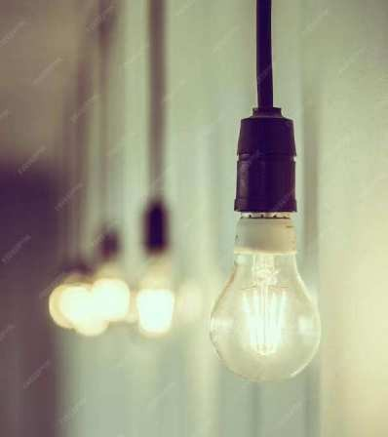
Powering up E ciency
Welcome to our presentation on energy consumption measurement! Today, we'll be exploring the secrets of measuring and optimizing energy usage to improve efﬁciency and reduce
costs.

Slide 29

Tools for Measuring Energy Consumption
There are many tools available for measuring energy consumption, including smart meters, submeters, and energy management systems. These tools can provide real-tim e data on energy usage and help identify areas for improvement. By using these tools, we can gain a better understanding of our energy consumption and make informed decisions to optimize efﬁciency.

Slide 30

Optimizing Energy Consumption
Once we have identiﬁed areas for improvement, we can implement changes to optimize energy consumption. This can include
upgrading equipment, implementing energy-efﬁcient practices, and adjusting schedules to reduce energy usage during peak hours. By optimizing energy consumption, we can reduce costs and improve our
environmental impact.

Slide 31
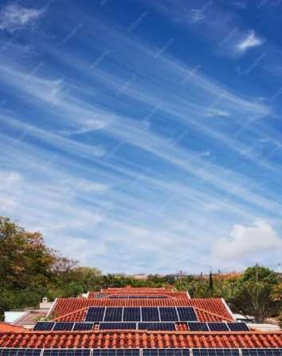
Case Study: Energy E ciency in Manufacturing
In this case study, we'll explore how a manufacturing company implemented energy- efﬁcient practices to reduce costs and improve efﬁciency. By implementing changes such as upgrading equipment and optimizing schedules, the company was able to reduce energy usage by 20%and save $100,000 annually.

Slide 32
Conclusion
By measuring and optimizing energy consumption, we can improve efﬁciency, reduce costs, and have a positive impact on the environment. With the right tools and practices in place, we can unlock the secrets of energy consumption measurement and power up our efﬁciency!

Slide 33
Measure Energy consumption development part-2
To develop a project for measuring energy consumption, you can follow these steps:
**Data Collection**:
Gather data related to energy consumption. This data might include information from smart
meters, IoT devices, or utility bills.
**Data Preprocessing**:
Clean the data, handle missing values, and format it for analysis.
Transform timestamps into usable time series data.
**Feature Engineering**:
Create relevant features based on your specific project requirements. This could include
aggregating data by time intervals, identifying patterns, or extracting relevant statistics.
**Model Selection**:
Depending on your project goals, select an appropriate model for energy consumption
forecasting or analysis. Time series forecasting models like ARIMA or machine learning models like regression or neural networks may be suitable.
**Model Training**:
Split your data into training and validation sets for model training.
Train the selected model on the training data.
**Evaluation**:
Evaluate the model's performance using appropriate metrics. For energy consumption,
metrics like Mean Absolute Error (MAE) or Root Mean Square Error (RMSE) may be relevant.
**Hyperparameter Tuning**:
Fine-tune the model by adjusting hyperparameters to improve forecasting accuracy.
**Regularization and Optimization**:
Apply techniques to prevent overfitting and optimize the model for energy consumption
predictions.
**Testing**:
Assess the model's performance on a separate test dataset to simulate real-world usage.
10. **Visualization**:
- Visualize the energy consumption data and model predictions. This can help in
understanding trends and patterns.
11. **Deployment**:

Slide 34
- Integrate the trained model into your energy management system or application to make real-time predictions or analysis.
12. **Monitoring and Maintenance**:
- Continuously monitor the model's performance and update it as needed with new data.
13. **Feedback Loop**:
- Collect feedback from users or energy management systems to improve the model over
time.
It's important to tailor your project to the specific requirements of your use case and the available data. If you have more specific questions or need guidance on a particular step, feel free to ask, and I can provide more detailed information.
Program :
# Input: Sample daily energy consumption data energy_data = [
{'date': '2023-10-01', 'consumption_kWh': 100}, {'date': '2023-10-02', 'consumption_kWh': 120},
{'date': '2023-10-03', 'consumption_kWh': 90}, # Add more data points here
]
# Output: Calculate average daily energy consumption def calculate_average_consumption(data):
total_consumption = 0 for entry in data:
total_consumption += entry['consumption_kWh'] num_entries = len(data)
average_consumption = total_consumption / num_entries return average_consumption
# Main program
if name == " main ":
average_daily_consumption = calculate_average_consumption(energy_data) print("Average
Daily Energy Consumption: {:.2f} kWh".format(average_daily_consumption))

Slide 35
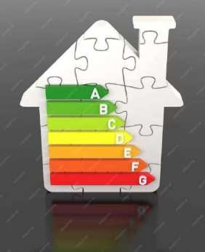
Introduction
Welcome to the presentation on Enhancing Energy Efﬁciency:A Comprehensive Approach to Measuring Energy Consumption. This presentation will explore the importance of measuring energy consumption and how it can help in improving energy efﬁciency. We will discuss various
methods and tools used for measuring energy consumption.

Slide 36
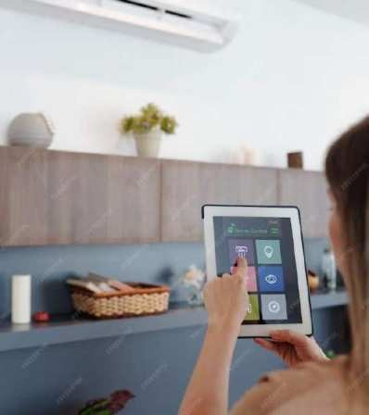
Why Measure Energy Consumption?
Measuring energy consumption is crucial for identifying areas of high
energy usage and potential inefﬁciencies. It helps in identifying energy-saving opportunities and making informed decisions to reduce energy consumption. Accurate energy measurements also enable effective monitoring and evaluation of energy
efﬁciency initiatives.

Slide 37
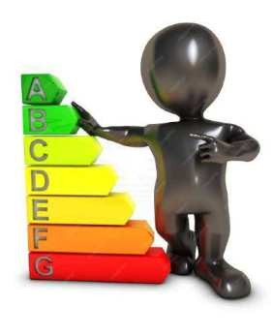
Key Metrics for Energy Consumption
There are several key metrics used to measure energy consumption, including energy intensity, energy performance indicators, and speciﬁc energy consumption. These metrics provide valuable insights into the energy efﬁciency of buildings, processes, and systems. By tracking these metrics, organizations can set targets, track progress, and benchmark against industry standards.

Slide 38
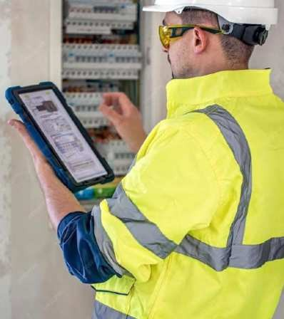
Methods for Measuring Energy Consumption
Various methods are employed to measure energy consumption, such as submetering, energy audits, and energy management systems.
Submetering allows for detailed
measurement of energy usage in
speciﬁc areas or equipment. Energy
audits provide a comprehensive assessm ent of energy consumption patterns and potential savings.
Energy management systems help in real-time monitoring and analysis of
energy data.

Slide 39

Tools for Measuring Energy Consumption
There are several tools available for measuring energy consumption, such as smart meters, data loggers, and building
energy management systems. Smart meters provide accurate and real-tim e energy usage data. Data loggers record energy consumption over a period of time for analysis.
Building energy management systems integrate multiple energy-related data sources for comprehensive monitoring and control.

Slide 40

Challenges in Measuring Energy Consumption
Measuring energy consumption can pose certain challenges, including data
accuracy, data availability, and data integration. Ensuring accurate and reliable energy data can be challenging due to various factors such as
measurement errors or equipment
malfunctions. Availability of energy data from different sources and its integration into a centralized system
can also be complex.

Slide 41
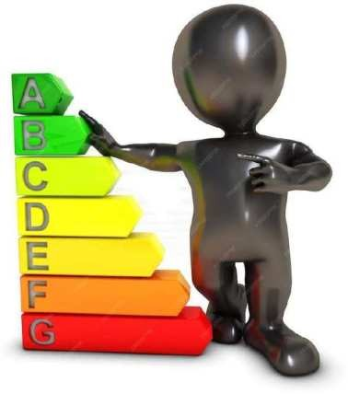
Beneﬁts of Measuring Energy Consumption
Measuring energy consumption brings several beneﬁts, including cost savings,
environmental sustainability, and improved operational efﬁciency. By identifying energy-saving opportunities, organizations can reduce energy costs and improve their bottom line. Energy efﬁciency also contributes to reduced greenhouse gas emissions and environmental impact.
Furthermore, measuring energy consumption helps in optimizing operational processes and
resource allocation.

Slide 42
Conclusion
In conclusion, measuring energy consumption is essential for enhancing energy efﬁciency. It provides valuable insights, helps in
identifying energy-saving opportunities, and enables effective monitoring and evaluation.
Despite the challenges, the beneﬁts of
measuring energy consumption outweigh the drawbacks. By adopting a comprehensive approach to measuring energy consumption, organizations can achieve signiﬁcant
improvements in energy efﬁciency and contribute to a sustainable future.

